Slide 1
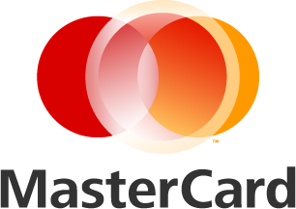
Overview of Virtual Card Payments
Chris Shanahan
Notes:
Study with over 200 CFOs and financial executives across multiple industries.

Slide 2
What CFO’s Are Saying…
Overwhelming proportion of CFOs see future payment processes leading away from the paper trail.
Finance executives expect to see more of a shift toward electronic payments alternatives from paper checks.
“Our intent is to move away from paper checks for security and efficiency reasons in the next 12 – 24 months.”
“Seeking higher-value payment processes through new technologies is the next logical step.”
Source: 2014 CFO Research. Accounts Payable Crossroads: The Next Phase for B2B Payments

Slide 3
Actions Speak Louder Than Words…
Use of Checks
(Mean Percentage of B2B Payments Made by Organization)
Check use for B2B payments is declining rapidly in the U.S. and across the world
Check use in the U.S. now represents only 50% of B2B payments
81%
74%
57%
50%
2013 Association of Financial Professional (AFP) Electronic Payments Survey
Notes:
Clearly checks are decreasng, however, cfos suggested that they will increases their ACH usage by 76% as they eliminate checks.

Slide 4
Purchasing Card Solutions Designed to Address Different Spend Categories
HIGH
Level of Automation
Straight Through Processing
$ Ticket Size
Virtual Cards
(i.e. Single and
Multi use accounts)
A/P Cards/
Ghost Cards
Traditional
Cards
Supplier-Initiated
Payments
LOW
HIGH
Strategic Importance / Level of Control Required

Slide 5
Current and Projected Purchasing Card Spend in North America
Source: RPMG 2014 Purchasing Card Benchmark Survey

Slide 6
Future Growth of Purchasing Card Platforms
Source: RPMG 2014 Purchasing Card Benchmark Survey

Slide 7
Reasons for Expected Future Increases in EAP Account Spending
Source: RPMG 2014 Purchasing Card Benchmark Survey

Slide 8
Why are More Vendors Accepting PCards?
Shorter Order-to-Cash Cycle
Card payment averages 3.8 days versus 37.9 days for traditional methods
Reduced labor and paperwork
Reduced bad debt
Increased working capital
Elimination of buyer-side errors
Research indicates that buyers are more likely to select Suppliers that accept cards
Card acceptance has been shown to promote loyalty and stickiness with customers
“It helps to get paid quickly. We can use that cash for other purposes, plus – and this is key – we decrease the odds that we’re not getting paid.”
- Credit & Collections Manager, Energy Supplier
“We had 6 clerks spend a total of 50-60 hours per week working on errors, reconciliation, cash applications, etc. With card (acceptance) that figure dropped to only a few hours per week.”
- Credit Manager, Food Supplier
Source: MasterCard and Kaiser Associates, Commercial Card Acceptance Cost-Benefit Study, November 2012

Slide 9
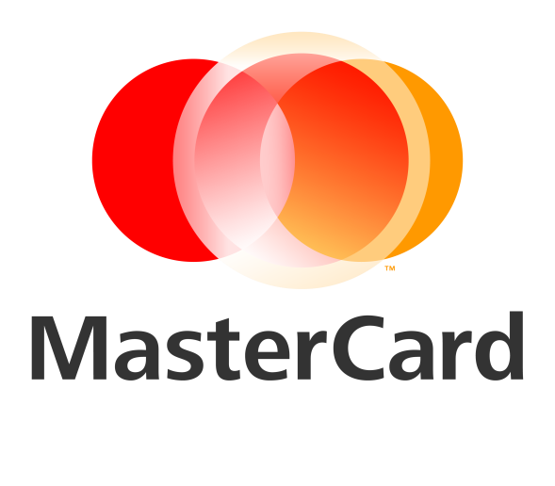
Benefits of Virtual Card Program
Eliminate manual processes
Reduce costs associated with paying by check
Easier tracking and reconciliation of payments
Earn a rebate on your spend
+
=

Slide 10
THANK YOU

Slide 11
©2015 MasterCard. The information provided herein is strictly confidential. It is intended to be used internally within your organization and cannot be distributed nor shared with any other third party without MasterCard’s prior approval. Information in this presentation or in any associated deliverable provided by MasterCard relating to the projected impact on either MasterCard’s or your financial or operating performance, as well as the results that you may expect, may constitute forward-looking statements and are subject to risks and uncertainties. No assurances are given that any of these concepts, projections, estimates or expectations will be achieved, that the analysis provided is error-free or that a particular asset, offer or benefit will be available. The information, including all forecasts, projections, or indications of financial opportunities, is provided to you on an "AS IS" basis for use at your own risk. You acknowledge and agree that MasterCard’s models, associated data and analysis may contain inaccuracies and inconsistencies, and MasterCard will not be responsible for any action you take as a result of this presentation, or any such inaccuracies or inconsistencies. In addition, you acknowledge and agree that MasterCard is under no obligation to update the information or provide notice if it discovers errors or omissions at any time. This information shall not create a legally binding or enforceable agreement or offer.

